Slide 1
Biodiversity in National Parks Data Analysis Report

Slide 2
Contents
Introduction
Analysis
Biodiversity by Categories
Biodiversity by Parks
Conservation status
Endangered Species
Threatened Species
Species of Concern
Distributions of Observations
Distributions of Observations by Categories
Distributions of Observations by National Parks
Distributions of Observations by Conservation Status
Conclusions

Slide 3
Introduction This study examines the biodiversity within four U.S. national parks: Yellowstone, Yosemite, Bryce, and Great Smoky Mountains. The dataset was sourced from the National Park Service and includes observation records of species in each park, along with information related to those species. The objective of this analysis is to assess the biodiversity by categories across these parks, identify species with specific conservation statuses, and analyze the distribution of observations based on categories, national parks, and conservation statuses.
However, the analysis focuses solely on the total number of observations or the number of species remaining. It does not consider other factors related to their conservation status, such as population trends over time or known threats to the species.

Slide 4
Analysis
Getting data from four national parks service, the dataset includes observations of each species found in each park.

Slide 5
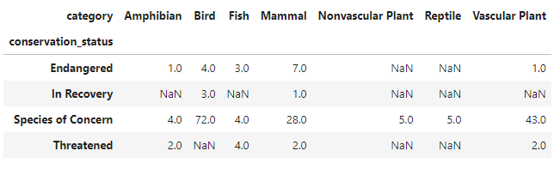
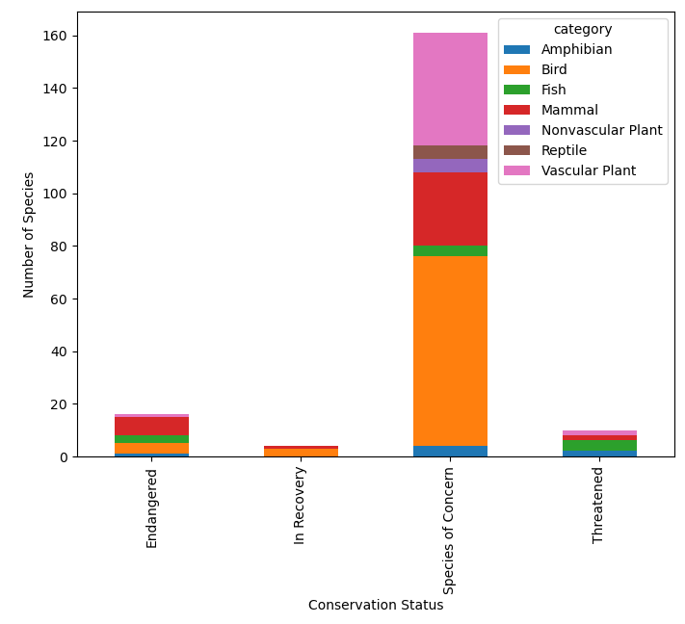
Conservation Status Per Category

Slide 6
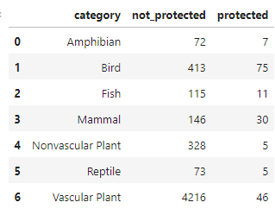
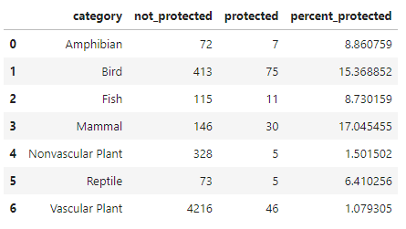
Protected Status
Each categories status of protection

Slide 7
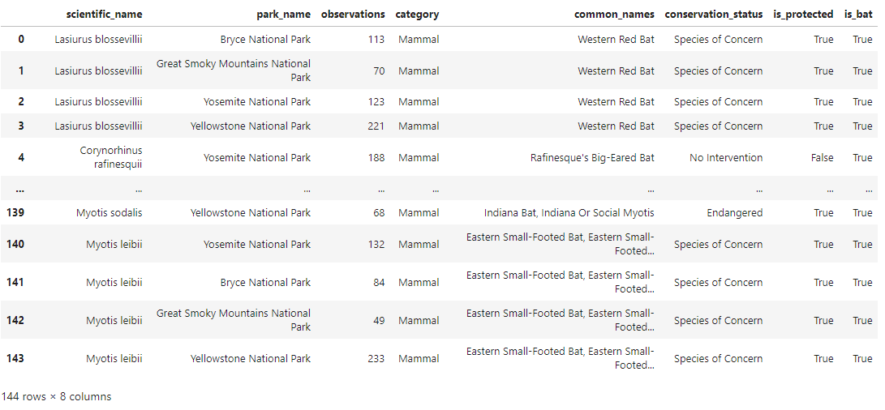
Results of the bat species will be merged with observations to create a Data Frame with observations of bats across the four national parks

Slide 8
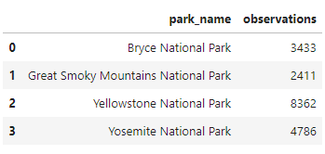
Total bat observations (across all species) were made at each national park

Slide 9
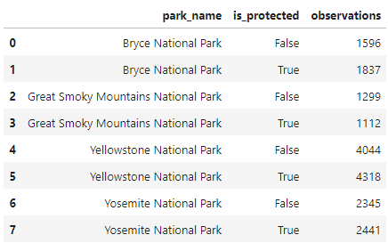
Each park broken down by protected bats vs. non-protected bat sightings

Slide 10
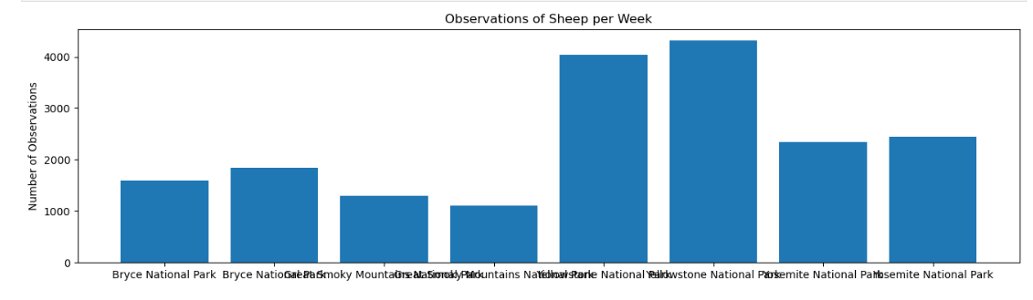
Plot from the output of the last data manipulation
From this chart one can see that Yellowstone and Bryce National Parks seem to be doing a great job with their bat populations since there are more sightings of protected bats compared to non-protected species. The Great Smoky Mountains National Park might need to beef up their efforts in conservation as they have seen more non-protected species.

Slide 11
Conclusion
There were 5,541 species of lives each national park. All of them can be divided into
seven categories: vascular plant, non-vascular plant, bird, fish, mammal, amphibian, and
reptile. Vascular plants had exceedingly high number of species (4,262 species). Meanwhile,
birds ranked the second place regarding their biodiversity (488 species). 3.21% of species
needed conservations. There were 151 species of concern, 9 species threatened, 15 species
Species within each conservation status category had varying ranges of observations, with some overlap between the groups. Threatened species had shorter observation ranges, while endangered species had the shortest ranges overall. For the threatened group, half of the species had between 50 and 100 observations. In contrast, half of the endangered group had between 25 and 50 observations. Additionally, there was a high density of endangered species with 25 observations

Slide 12
Conclusion
However, the severity levels varied across the different national parks. In Great Smoky Mountains National Park, the number of these animals was low, with about 10 observations per species. Similarly, Bryce National Park also had small numbers, ranging from 20 to 30 observations. These numbers corresponded with the total number of observations, as Great Smoky Mountains and Bryce National Parks had the fewest observations compared to other parks.
The distribution of observations was consistent across all seven categories, but there were noticeable differences in observations based on the national park. Most species in Yellowstone National Park had the highest number of observations. Half of the species in Yellowstone, Yosemite, Bryce, and Great Smoky Mountains had approximately 250, 150, 100, and 75 observations, respectively. This suggests that Great Smoky Mountains might be considered at risk.

Slide 13
Thank you
Brita Tamm
502-555-0152
brita@firstupconsultants.com
www.firstupconsultants.com

